Slide 1
GhostRoute: Energy-Aware, Detection-Minimizing Path Planning
CDT Jacob Hyatt, LTC James Grymes,
Dr. Robert Jane, and COL Corey James

Slide 2


Sponsor
Dr. Robert Jane
COL Corey James

Slide 3
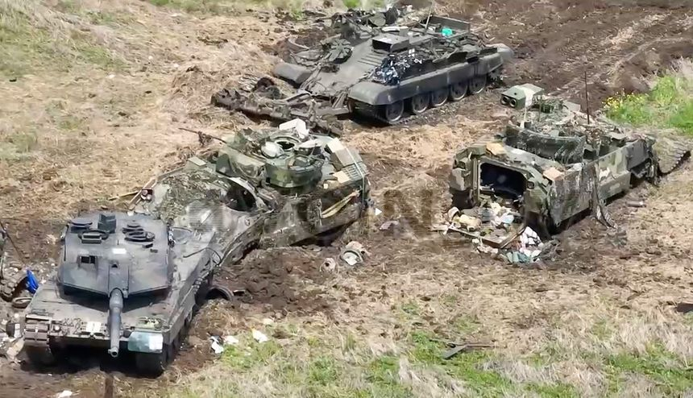
Contested Environments
Detection and Energy balance is important for survival
The War Zone 09JUN2023
Notes:
1/3 of Ukraine’s Bradley’s have been destroyed or damaged as of FEB 2025

Slide 4
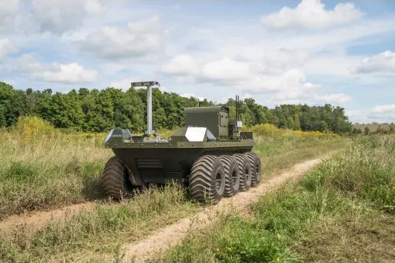
Contested Environments
Methodology to balance Detection and Energy
Clearpath Robotics
Notes:
1/3 of Ukraine’s Bradley’s have been destroyed or damaged as of FEB 2025

Slide 5
Previous Work
Very Brief explanation maybe
Show picture of walking sneeking crawling
MAJ Kendall maybe?

Slide 6
Methodology
Collection Phase
Transformation Phase
Optimization Phase
Enemy
Locations
Detection Costs
Landsat 8
Satellite Imagery
Vegetation Density
Node
Network
Optimization Function
Digital Elevation Model
Energy Costs
Output
Path

Slide 7
Methodology
Collection Phase
Transformation Phase
Optimization Phase
Enemy
Locations
Detection Costs
Landsat 8
Satellite Imagery
Vegetation Density
Node
Network
Optimization Function
Digital Elevation Model
Energy Costs
Output
Path

Slide 8
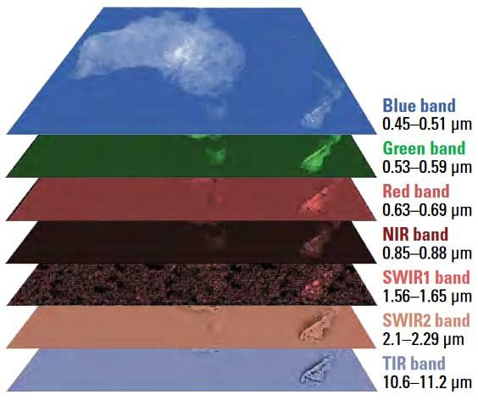
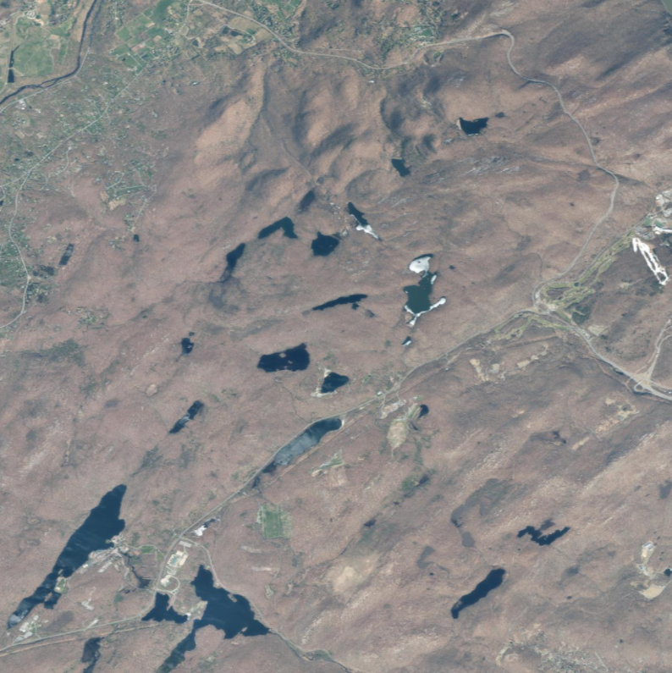
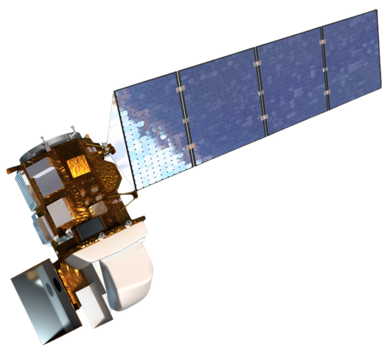

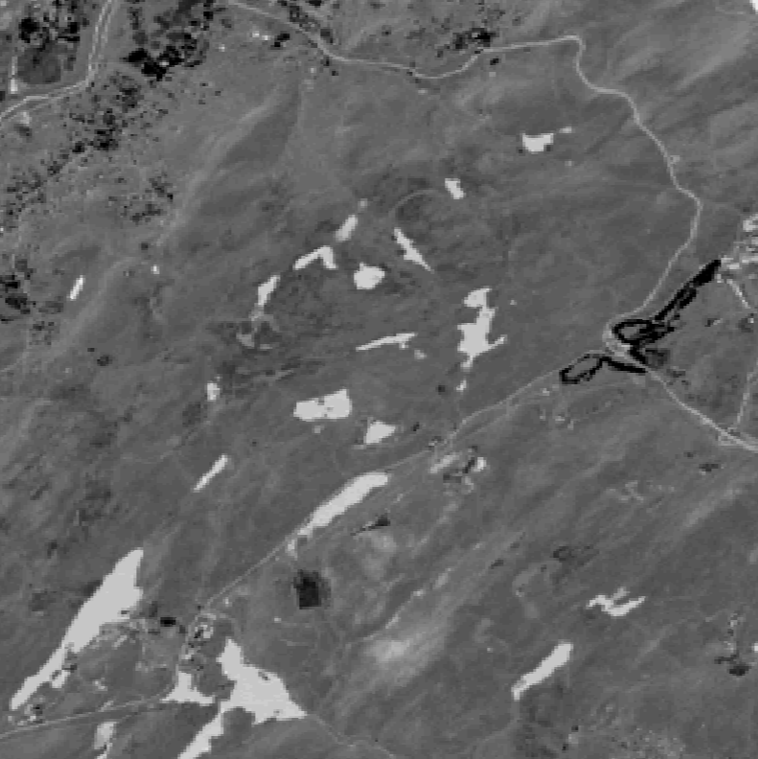
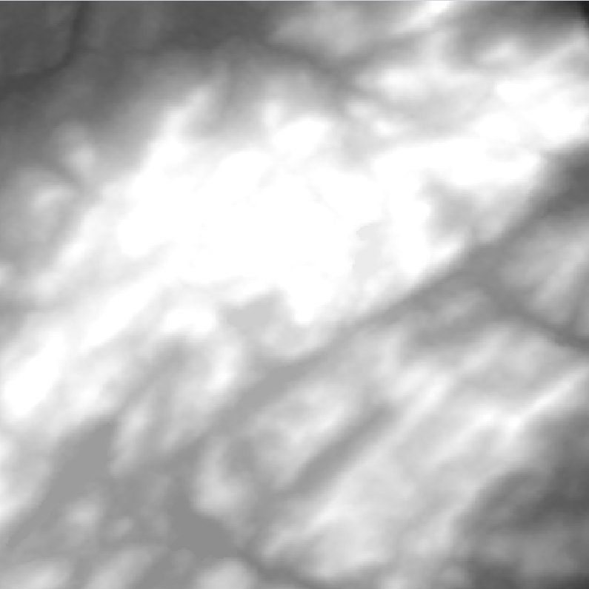
Area of Operations
Landsat 8

Slide 9

Elevation
Digital Elevation Model: 3D representation of the Area of Operations

Slide 10
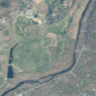
Area of Operations
S
F

Slide 11

Enemy Locations
Military Intelligence (S2) provides the locations and dispositions of enemies in the Area of Operations

Slide 12
Enemy Locations
S
E
E
F

Slide 13
Methodology
Collection Phase
Transformation Phase
Optimization Phase
Enemy
Locations
Detection Costs
Landsat 8
Satellite Imagery
Vegetation Density
Node
Network
Optimization Function
Digital Elevation Model
Energy Costs
Output
Path

Slide 14
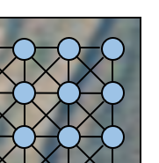
Node Network (start and finish) grab
Arc Weights:
Energy
Detection

Slide 15




Node Network
Top View
Side View
$$n_{1}$$
$$n_{w}$$
Charging Level
Charged Level
$$n_{l}$$
$$n_{wl}$$

Slide 16

Vegetation (add scale)
$$\text{NDVI}= \frac{(\text{NIR} − \text{RED})}{(\text{NIR} + \text{RED})}$$
Normalized difference vegetation index as a proxy for vegetation density

Slide 17
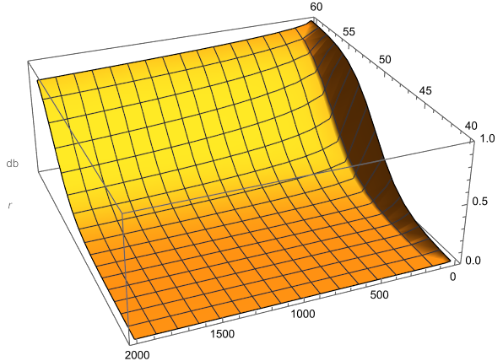
Audio Detection
Audio Detection: uses inverse square law to calculate propagation of audio
Audio Detection Decay
dB
p
distance

Slide 18
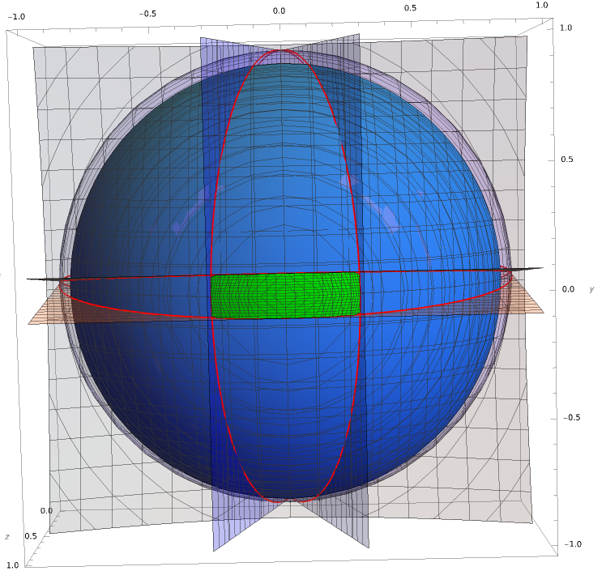
Visual Detection
Visual Detection: utilizes line of sight and the total area that the UGV occupies in the seeker’s vision field

Slide 19
Node Network

Slide 20
Node Network
Elevation and Vegetation
at each node

Slide 21
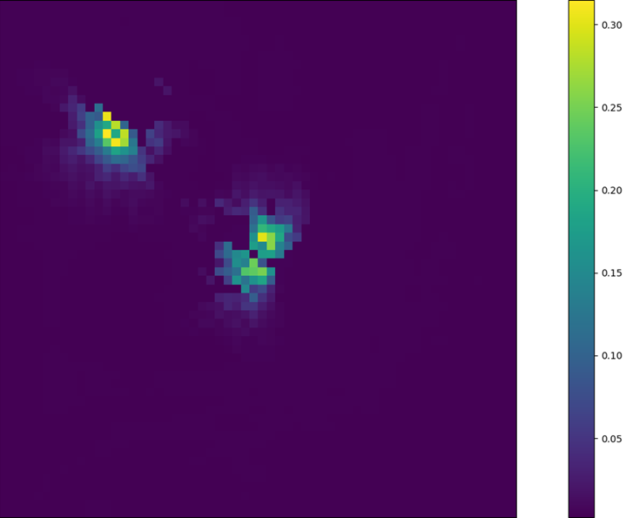
Detection Visualized
S
E
E
F
Maximum value of the visual and audio detection functions for worst case scenario

Slide 22
Energy Costs
1 Degree of Freedom Equation of Motion Equation
Accounts for regenerative braking and generator state of charge

Slide 23
Generator (show the addition of node network layer 2)
Generator On
Generator Off

Slide 24
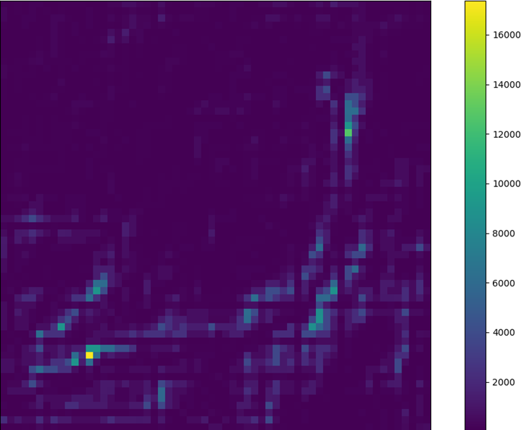
Energy Visualized (log scale)
S
E
E
F

Slide 25
Methodology
Collection Phase
Transformation Phase
Optimization Phase
Enemy
Locations
Detection Costs
Landsat 8
Satellite Imagery
Vegetation Density
Node
Network
Optimization Model
Digital Elevation Model
Energy Costs
Output
Path

Slide 26
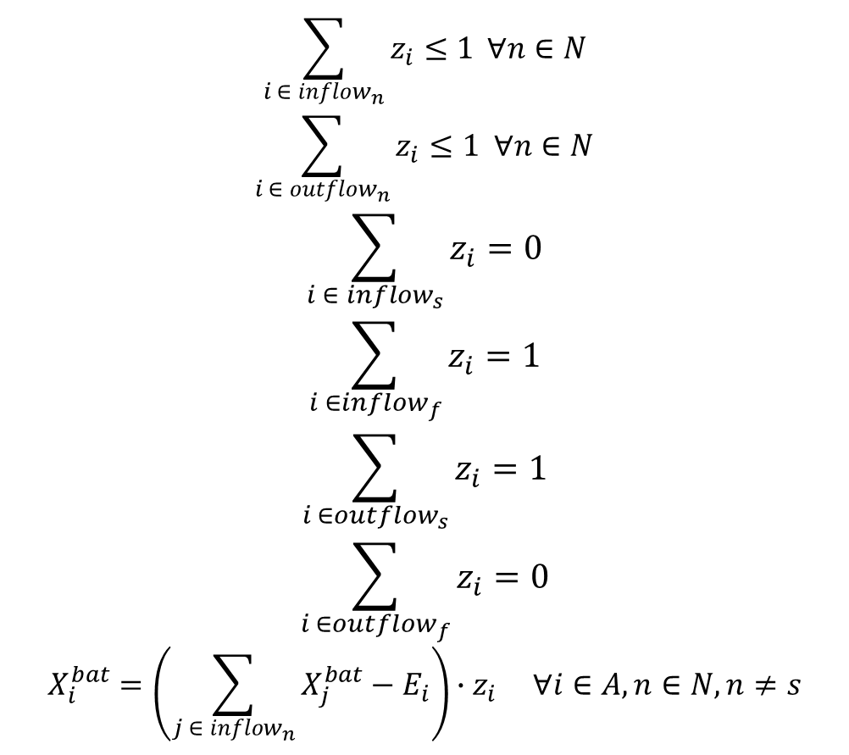
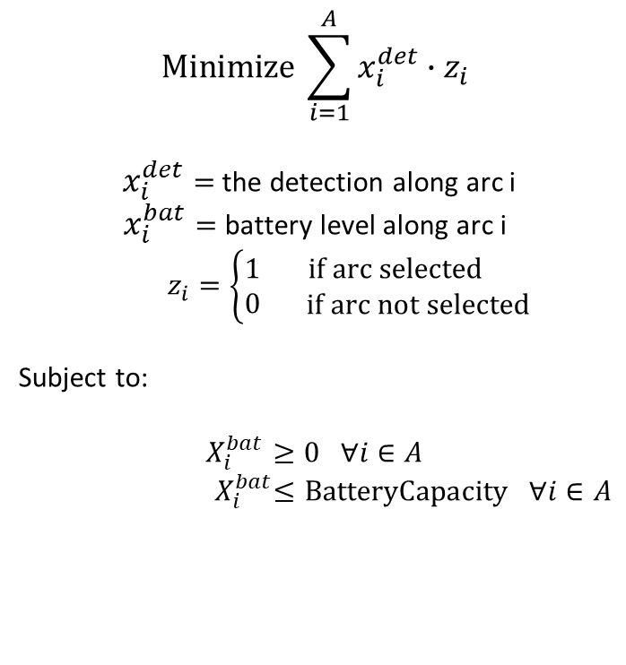
Optimization Model (transform to ij)
$$\sum_{i ∈ inflow_{n}}{z_{i}≤1} ∀n∈N$$
$$\sum_{i ∈ outflow_{n}}{z_{i}≤1 ∀n∈N }$$
$$\sum_{i ∈ {inflow}_{s}}{z_{i}}=0$$
$$\sum_{i ∈{inflow}_{f}}{z_{i}}=1$$
$$\sum_{i ∈{outflow}_{s}}{z_{i}}=1$$
$$\sum_{i ∈{outflow}_{f}}{z_{i}}=0$$
$$X_{i}^{bat}=\left(\sum_{j ∈ inflow_{n}}{X_{j}^{bat}−E_{i}}\right)∙z_{i} ∀i∈A, n∈N, n≠s$$
$$\text{Minimize} \sum_{i=1}^{A}{x_{i}^{det}∙z_{i}}$$
$x_{i}^{det}=$ the detection along arc i
$x_{i}^{bat}=$battery level along arc i
$z_{i}=\left\{\begin{aligned}1 \\ 0\end{aligned}\begin{matrix}\text{if} \text{arc} \text{selected} \\ \text{if} \text{arc} \text{not} \text{selected}\end{matrix}\right.$
Subject to:
$X_{i}^{bat}≥0 ∀i∈A$
${ X}_{i}^{bat}≤\text{BatteryCapacity} ∀i∈A$

Slide 27
Optimization Model
Minimize total detection across path
Subject to:
Flow Constraints to model path
Battery Constraints to ensure an energy feasible path

Slide 28
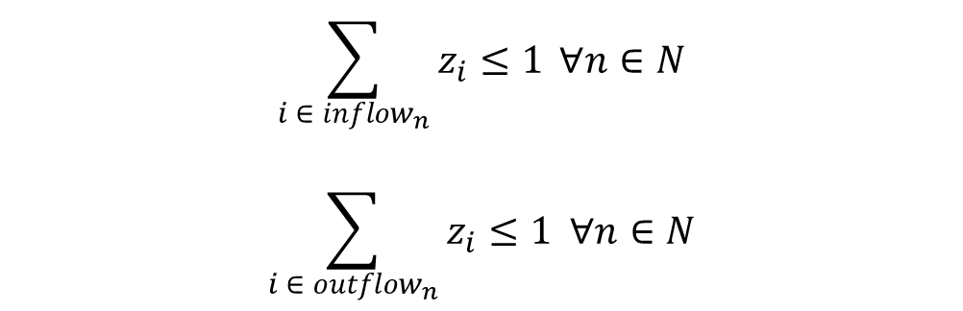
Flow Constraints
At most only 1 arc into and out of any given node
$$\sum_{i ∈ inflow_{n}}{z_{i}≤1} ∀n∈N$$
$$\sum_{i ∈ outflow_{n}}{z_{i}≤1 ∀n∈N }$$
S
2
2
S
1
S
S
1
F
F
F
3
4
3
4
F

Slide 29
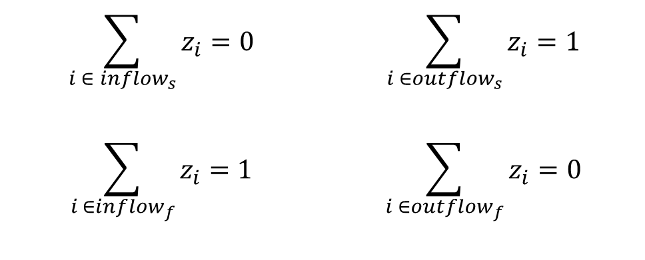
Specialty Flow Constraints
Special Considerations to define the Start and End node
$$\sum_{i ∈ {inflow}_{s}}{z_{i}}=0$$ | $$\sum_{i ∈{outflow}_{s}}{z_{i}}=1$$
$$\sum_{i ∈{inflow}_{f}}{z_{i}}=1$$ | $$\sum_{i ∈{outflow}_{f}}{z_{i}}=0$$
S
1
2
S
1
2
3
4
F
3
4
F

Slide 30
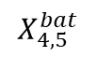

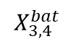
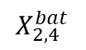
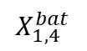
Battery Constraints
Battery state of charge must not exceed max or go below 0
$X_{i}^{bat}≥0 ∀i∈A$
${ X}_{i}^{bat} ≤\text{BatteryCapacity} ∀i∈A$
1
$$X_{1,4}^{bat}$$
$$X_{2,4}^{bat}$$
2
4
5
$$X_{4,5}^{bat}$$
$$X_{3,4}^{bat}$$
3

Slide 31

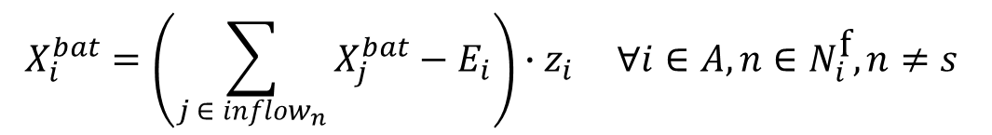
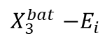
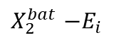
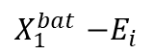
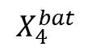
Battery Constraints (center)
Battery state of charge must not exceed max or go below 0
Tracking the change in battery from node to node
$$X_{i}^{bat}=\left(\sum_{j ∈ inflow_{n}}{X_{j}^{bat}−E_{i}}\right)∙z_{i} ∀i∈A, n∈N_{i}^{\text{f}}, n≠s$$
$X_{i}^{bat}≥0 ∀i∈A$
${ X}_{i}^{bat} ≤\text{BatteryCapacity} ∀i∈A$
1
$X_{1}^{bat}$ $−E_{i}$
$X_{2}^{bat}$ $−E_{i}$
2
4
5
$$X_{4}^{bat}$$
$X_{3}^{bat}$ $−E_{i}$
3
Notes:
Track battery state of charge across each arc

Slide 32
Methodology (black box throw away)
Collection Phase
Transformation Phase
Optimization Phase
Enemy
Locations
Detection Costs
Landsat 8
Satellite Imagery
Vegetation Density
Node
Network
Optimization Function
Digital Elevation Model
Energy Costs
Output
Path

Slide 33
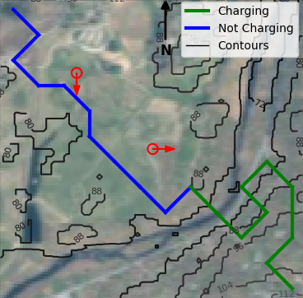
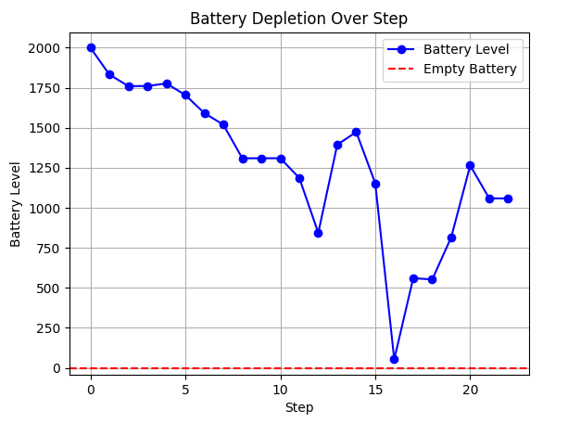
Results

Slide 34
Conclusion
We propose a methodology for autonomous vehicle route planning that balances energy efficiency and stealth to enhance mission success.
Future Work
Refine path restrictions (cliffs, water, marshes)
Testing on Vehicle
Charging in Place

